Slide 1

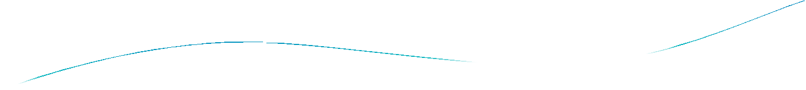



Section 10.2

Slide 2

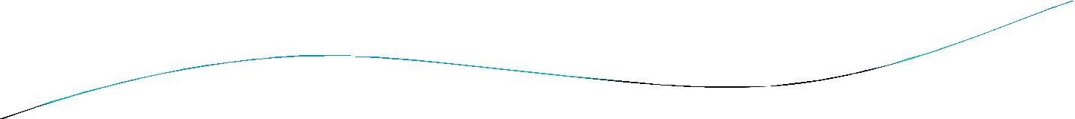
Section Summary
Basic Terminology
Some Special Types of Graphs
Bipartite Graphs
Bipartite Graphs and Matchings
Some Applications of Special Types of Graphs
New Graphs from Old

Slide 3


Basic Terminology
Definition 1. Two vertices u, v in an undirected graph G are called adjacent (or neighbors) in G if there is an edge e between u and v. Such an edge e is called incident with the vertices u and v and e is said to connect u and v.
Definition 2. The set of all neighbors of a vertex v of G = (V, E), denoted by N(v), is called the neighborhood of v. If A is a subset of V, we denote by N(A) the set of all vertices in G that are adjacent to at least one vertex in A. So,
Definition 3. The degree of a vertex in a undirected graph is the number of edges incident with it, except that a loop at a vertex contributes two to the degree of that vertex. The degree of the vertex v is denoted by deg(v).

Slide 4

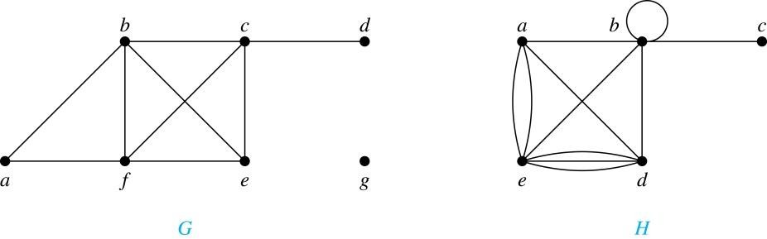
Degrees and Neighborhoods of Vertices
Example: What are the degrees and neighborhoods of the vertices in the graphs G and H?
Solution:
G: deg(a) = 2, deg(b) = deg(c) = deg(f ) = 4, deg(d ) = 1, deg(e) = 3, deg(g) = 0.
N(a) = {b, f }, N(b) = {a, c, e, f }, N(c) = {b, d, e, f }, N(d) = {c},
N(e) = {b, c , f }, N(f) = {a, b, c, e}, N(g) = ∅ .
H: deg(a) = 4, deg(b) = deg(e) = 6, deg(c) = 1, deg(d) = 5.
N(a) = {b, d, e}, N(b) = {a, b, c, d, e}, N(c) = {b}, N(d) = {a, b, e},
N(e) = {a, b ,d}.

Slide 5

Handshaking Theorem
Theorem: If G is any graph, then the sum of the degrees of all the vertices of G equals twice the number of edges of G.
Specifically, if the vertices of G are v1, v2, …, vn, where n is a positive integer, then
the total degree of G = deg(v1) + deg(v2) + … + deg(vn)
= 2 . (the number of edges of G)
PROOF:
Each edge “e” of G connects its end points vi and vj. This edge,
therefore contributes 1 to the degree of vi and 1 to the degree of vj.
If “e” is a loop, then it is counted twice in computing the degree of the vertex on which it is incident.
Accordingly, each edge of G contributes 2 to the total degree of G. Thus, the total degree of G = 2. (the number of edges of G)
COROLLARY: The total degree of G is an even number

Slide 6

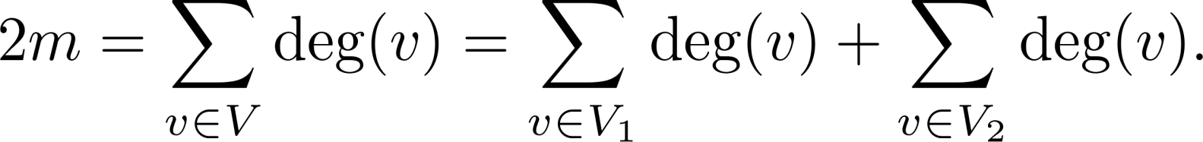

Degree of Vertices
Theorem: An undirected graph has an even number of
vertices of odd degree.
Proof: Let V₁ be the vertices of even degree and V₂ be the vertices of odd degree in an undirected graph G = (V, E) with m edges. Then
even
must be even since deg(v) is even for each v ∈ V₁
This sum must be even because 2m is even and the sum of the degrees of the vertices of even degrees is also even. Because this is the sum of the degrees of all vertices of odd degree in the graph, there must be an even number of such vertices.

Slide 7

Handshaking Theorem
We now give two examples illustrating the usefulness of the
handshaking theorem.
Example: How many edges are there in a graph with 10
vertices of degree six?
Solution: Because the sum of the degrees of the vertices is 6 ⋅ 10 = 60, the handshaking theorem tells us that 2m = 60. So the number of edges m = 30.
Example: If a graph has 5 vertices, can each vertex have degree
3?
Solution: This is not possible by the handshaking theorem, because the sum of the degrees of the vertices 3 ⋅ 5 = 15 is odd.

Slide 8

Directed Graphs
Recall the definition of a directed graph.
Definition: An directed graph G = (V, E) consists of V, a nonempty set of vertices (or nodes), and E, a set of directed edges or arcs. Each edge is an ordered pair of vertices. The directed edge (u,v) is said to start at u and end at v.
Definition: Let (u,v) be an edge in G. Then u is the initial vertex of this edge and is adjacent to v and v is the terminal (or end) vertex of this edge and is adjacent from u. The initial and terminal vertices of a loop are the same.

Slide 9

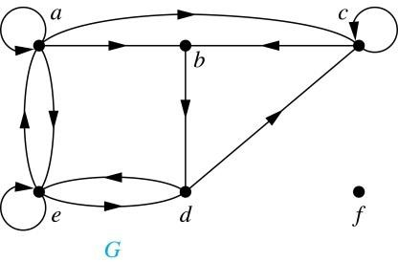
Directed Graphs (continued)
Definition: The in-degree of a vertex v, denoted deg⁻(v), is the number of edges which terminate at v. The out-degree of v, denoted deg⁺(v), is the number of edges with v as their initial vertex. Note that a loop at a vertex contributes 1 to both the
in-degree and the out-degree of the vertex.
Example: In the graph G we have
deg⁻(a) = 2, deg⁻(b) = 2, deg⁻(c) = 3, deg⁻(d) = 2, deg⁻(e) = 3, deg⁻(f) = 0.
deg⁺(a) = 4, deg⁺(b) = 1, deg⁺(c) = 2, deg⁺(d) = 2, deg⁺ (e) = 3, deg⁺(f) = 0.

Slide 10

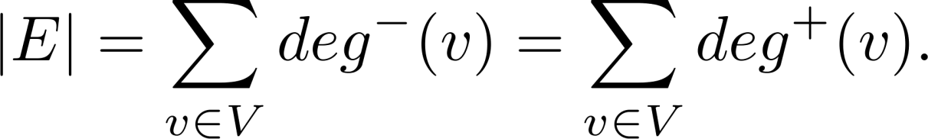
Directed Graphs (continued)
Theorem 3: Let G = (V, E) be a graph with directed edges. Then:
Proof: The first sum counts the number of outgoing edges over all vertices and the second sum counts the number of incoming edges over all vertices. It follows that both sums equal the number of edges in the graph.

Slide 11

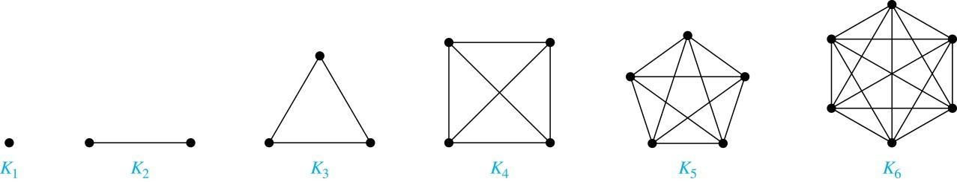
Special Types of Simple Graphs: Complete Graphs
A complete graph on n vertices, denoted by K_{n}, is the simple graph that contains exactly one edge between each pair of distinct vertices.

Slide 12

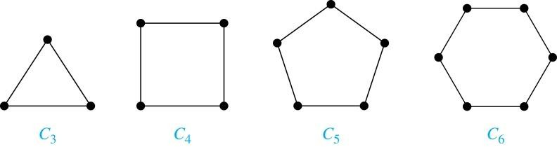
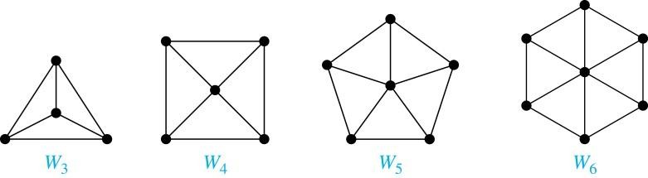
Special Types of Simple Graphs: Cycles and Wheels
A cycle C_{n} for n ≥ 3 consists of n vertices v₁, v₂ ,⋯ , v_{n}, and edges {v₁, v₂}, {v₂, v₃} ,⋯ , {v_{n-1}, v_{n}}, {v_{n}, v₁}.
A wheel W_{n} is obtained by adding an additional vertex to a cycle C_{n} for n ≥ 3 and connecting this new vertex to each of the n vertices in C_{n} by new edges.

Slide 13

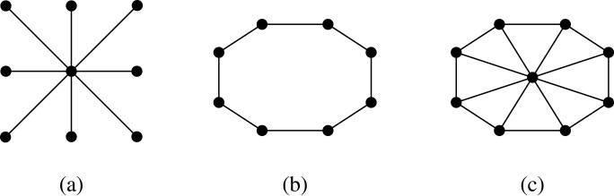
Special Types of Graphs and Computer Network Architecture
Various special graphs play an important role in the design of
computer networks.
Some local area networks use a star topology, which is a complete bipartite graph K_{1,n} ,as shown in (a). All devices are connected to a central control device.
Other local networks are based on a ring topology, where each device is connected to exactly two others using C_{n} ,as illustrated in (b). Messages may be sent around the ring.
Others, as illustrated in (c), use a W_{n} – based topology, combining the features of a star topology and a ring topology.

Slide 14

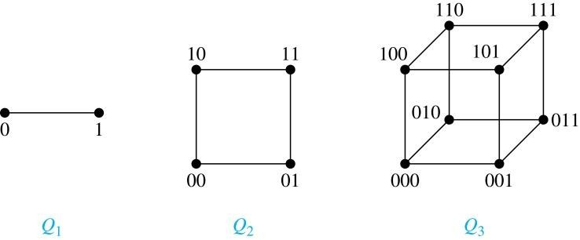
Special Types of Simple Graphs:
n-Cubes
An n-dimensional hypercube, or n-cube, Q_{n}, is a graph with 2^{n} vertices representing all bit strings of length n, where there is an edge between two vertices that differ in exactly one bit position.

Slide 15

Bipartite Graphs
Definition: A simple graph G is bipartite if V can be partitioned into two disjoint subsets V₁ and V₂ such that every edge connects a vertex in V₁ and a vertex in V₂. In other words, there are no edges which connect two vertices in V₁ or in V₂.
It is not hard to show that an equivalent definition of a bipartite graph is a graph where it is possible to color the vertices red or blue so that no two adjacent vertices are the same color.

Slide 16
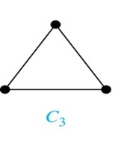
Bipartite Graphs (continued)
Example: Show that C₃ is not bipartite.
Solution: If we divide the vertex set of C₃ into two nonempty sets, one of the two must contain two vertices. But in C₃ every vertex is connected to every other vertex. Therefore, the two vertices in the same partition are connected. Hence, C₃ is not bipartite.

Slide 17

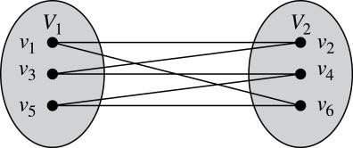
Bipartite Graphs (continued)
Example: Show that C₆ is bipartite.
Solution: We can partition the vertex set into
V₁ = {v₁, v₃, v₅} and V₂ = {v₂, v₄, v₆} so that every edge of C₆ connects a vertex in V₁ and V₂ .

Slide 18

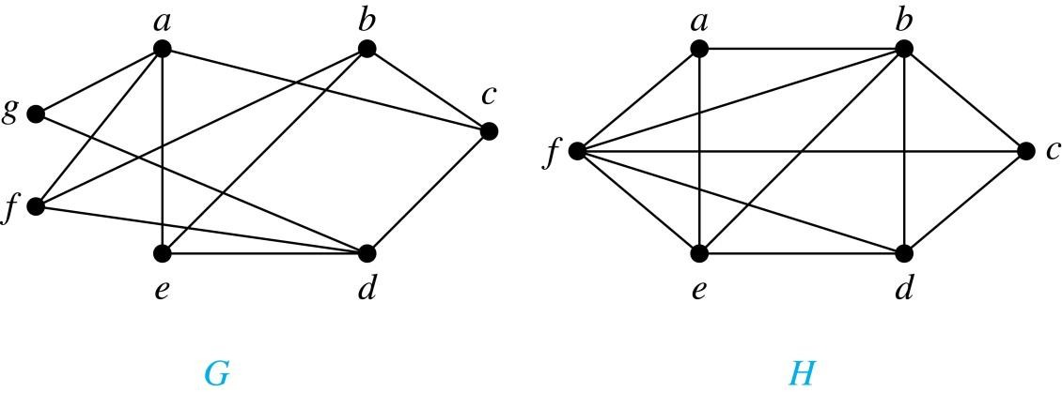
Bipartite Graphs
G is bipartite
H is not bipartite since if we color a red, then the adjacent vertices f and b must both be blue.

Slide 19
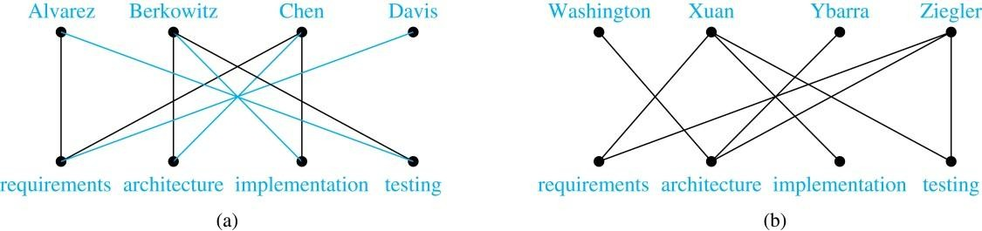
Bipartite Graphs and Matchings
Bipartite graphs are used to model applications that involve matching the elements of one set to elements in another, for example:
Job assignments - vertices represent the jobs and the employees, edges link employees with those jobs they have been trained to do. A common goal is to match jobs to employees so that the most jobs are done.

Slide 20

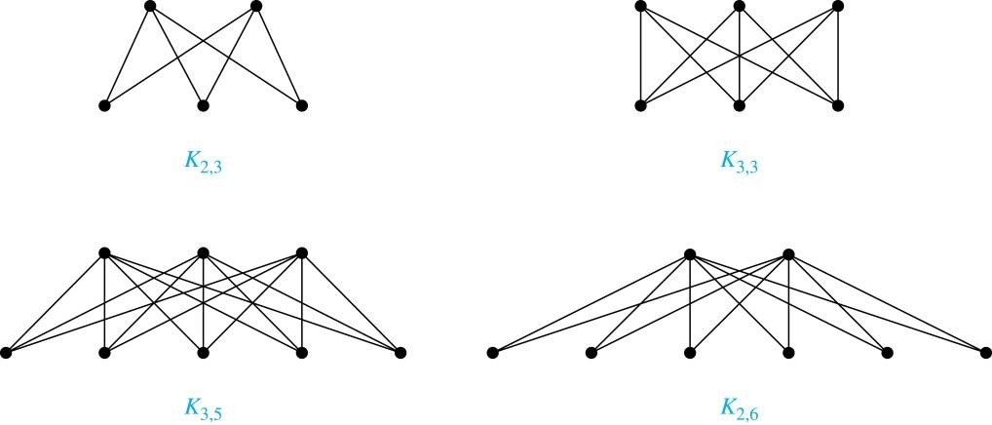
Complete Bipartite Graphs
Definition: A complete bipartite graph K_{m,n} is a graph that has its vertex set partitioned into two subsets V₁ of size m and V₂ of size n such that there is an edge from every vertex in V₁ to every vertex in V₂.
Example: We display four complete bipartite graphs here.

Slide 21

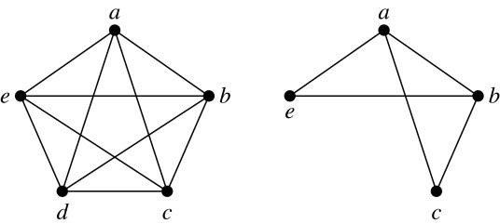
New Graphs from Old
Definition: A subgraph of a graph G = (V,E) is a graph (W,F), where W ⊂ V and F ⊂ E. A subgraph H of G is a proper subgraph of G if H ≠ G.
Example: Here we show K₅ and one of its subgraphs.
Definition: Let G = (V, E) be a simple graph. The subgraph induced by a subset W of the vertex set V is the graph (W,F), where the edge set F contains an edge in E if and only if both endpoints are in W.
Example: Here we show K₅ and the subgraph induced by W =
{a,b,c,e}.

Slide 22

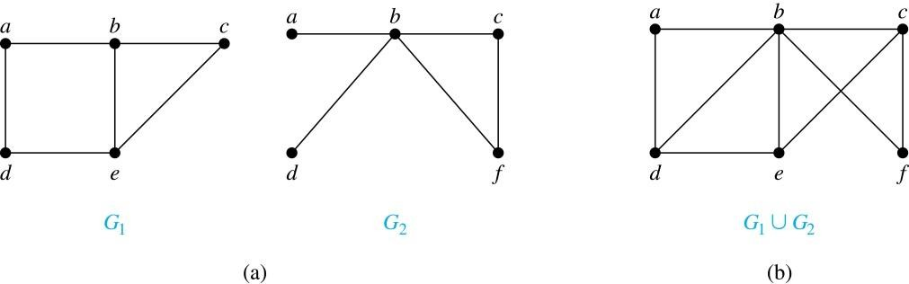
New Graphs from Old (continued)
Definition: The union of two simple graphs G₁ = (V₁, E₁) and G₂ = (V₂, E₂) is the simple graph with vertex set V₁ ⋃ V₂ and edge set E₁ ⋃ E₂. The union of G₁ and G₂ is denoted by G₁ ⋃ G₂.
Example:

Slide 23
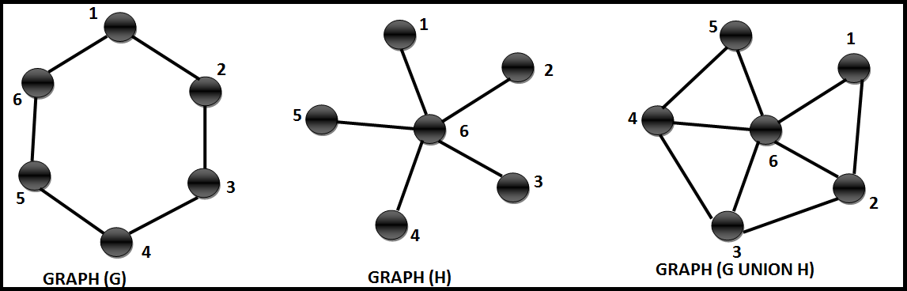
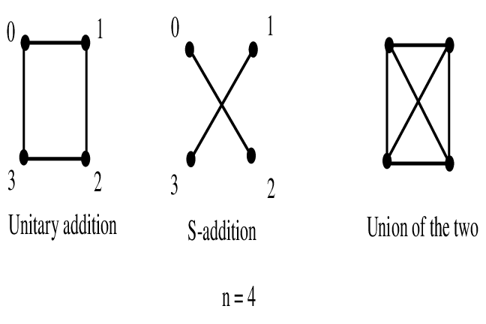

Slide 24
